Slide 1
Conditional Generative Adversarial Networks
Jia-Bin Huang
Virginia Tech
ECE 6554 Advanced Computer Vision

Slide 2
Today’s class
Discussions
Review basic ideas of GAN
Examples of conditional GAN
Experiment presentation by Sanket

Slide 3
Why Generative Models?
Excellent test of our ability to use high-dimensional, complicated probability distributions
Simulate possible futures for planning or simulated RL
Missing data
Semi-supervised learning
Multi-modal outputs
Realistic generation tasks
(Goodfellow 2016)

Slide 4
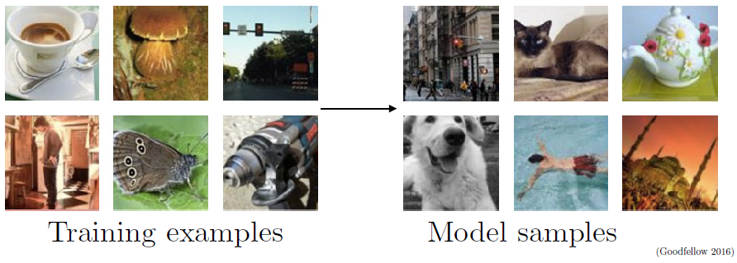
Generative Modeling
Density estimation
Sample generation

Slide 5
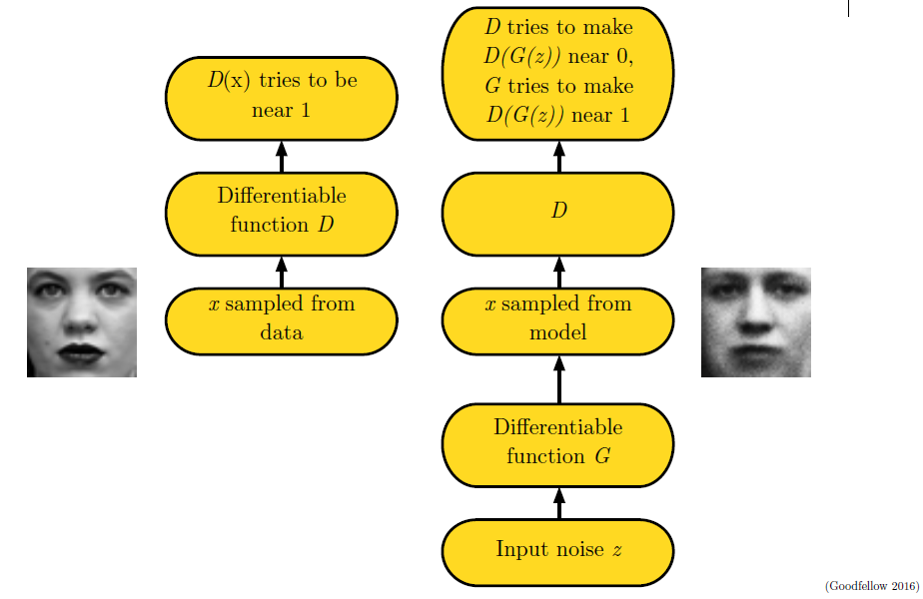
Adversarial Nets Framework

Slide 6
Training Procedure
Use SGD-like algorithm of choice (Adam) on two minibatches simultaneously:
A minibatch of training examples
A minibatch of generated samples
Optional: run k steps of one player for every step of the other player.
(Goodfellow 2016)

Slide 7
Minimax Game
Equilibrium is a saddle point of the discriminator loss
Resembles Jensen-Shannon divergence
Generator minimizes the log-probability of the discriminator being correct
(Goodfellow 2016)

Slide 8
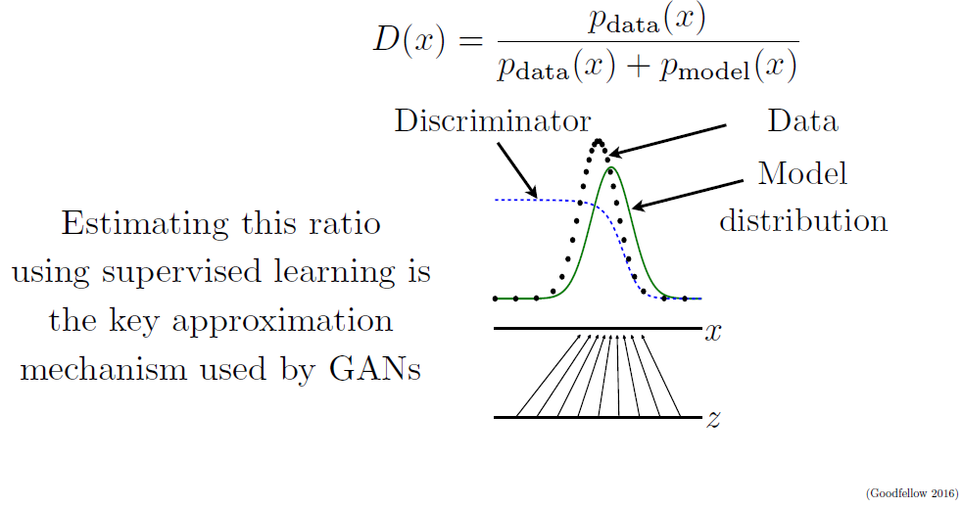
Discriminator Strategy
Optimal discrimator

Slide 9
Non-Saturating Game
Equilibrium no longer describable with a single loss
Generator maximizes the log-probability of the discriminator being mistaken
Heuristically motivated; generator can still learn even when discriminator successfully rejects all generator samples
(Goodfellow 2016)

Slide 10
Review: GAN
GANs are generative models that use supervised learning to approximate an intractable cost function
GANs can simulate many cost functions, including the one used for maximum likelihood
Finding Nash equilibria in high-dimensional, continuous, nonconvex games is an important open research problem

Slide 11
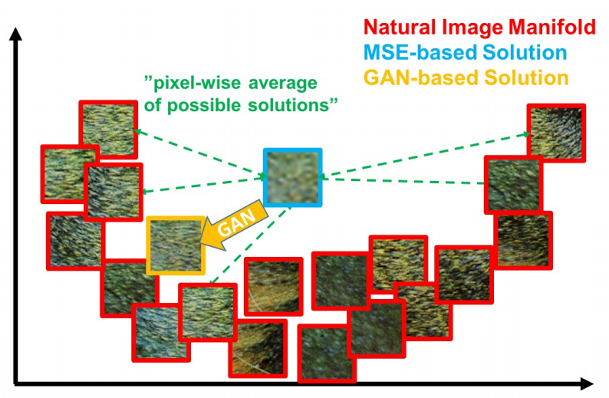
Conditional GAN
Learn P(Y|X)
[Ledig et al. CVPR 2017]

Slide 12
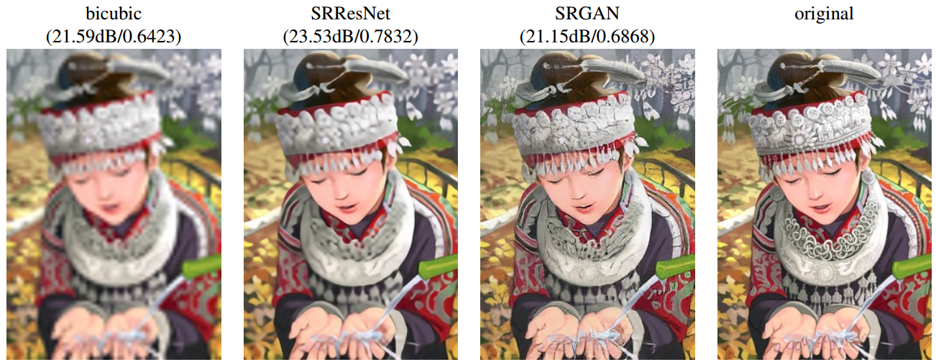
Image Super-Resolution
Conditional on low-resolution input image
[Ledig et al. CVPR 2017]

Slide 13
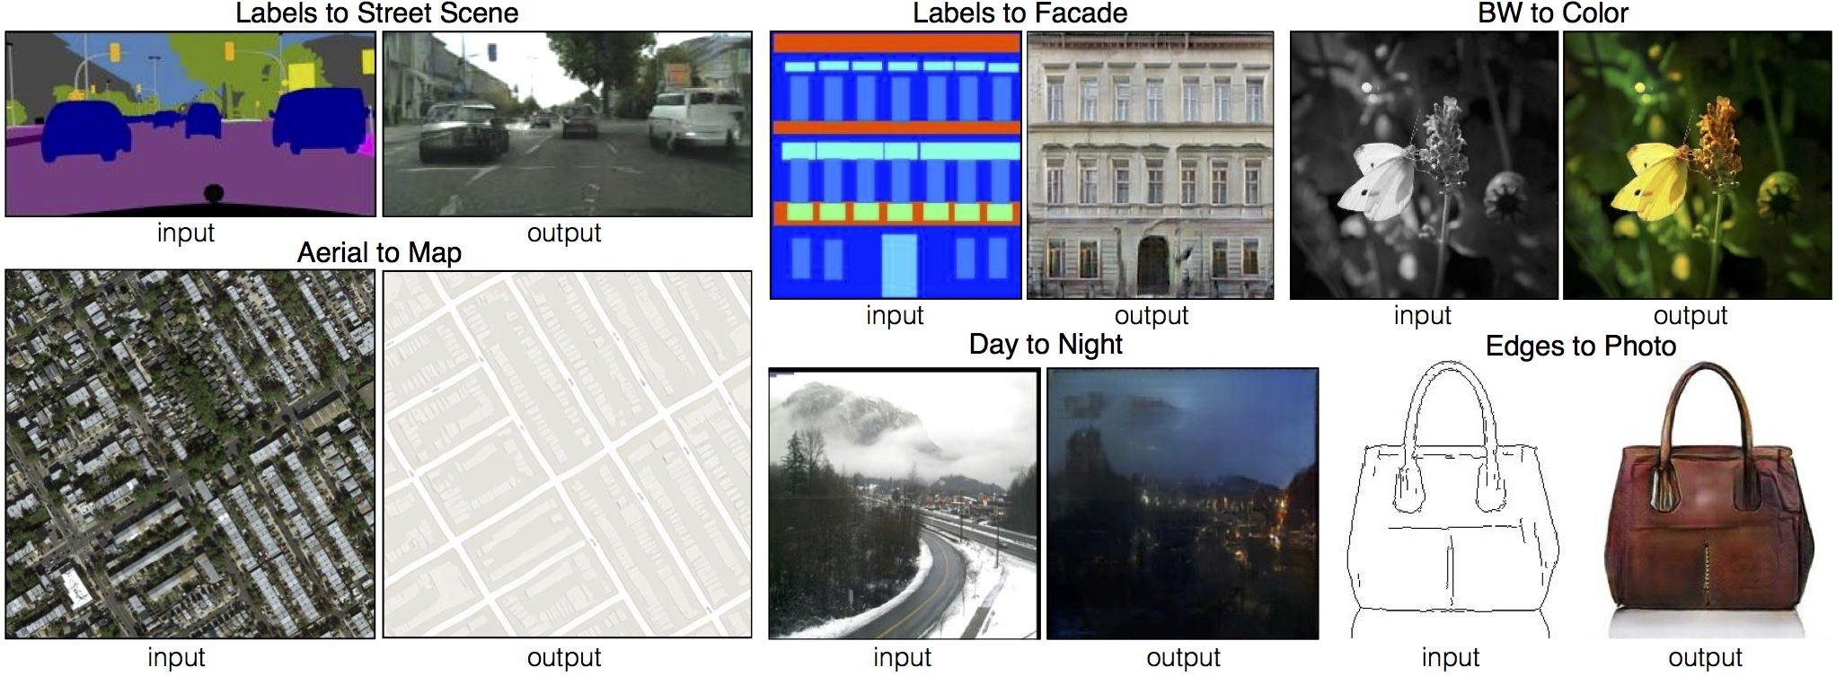
Image-to-Image Translation
Conditioned on an image of different modality
No need to specify the loss function
[Isola et al. CVPR 2017]

Slide 14
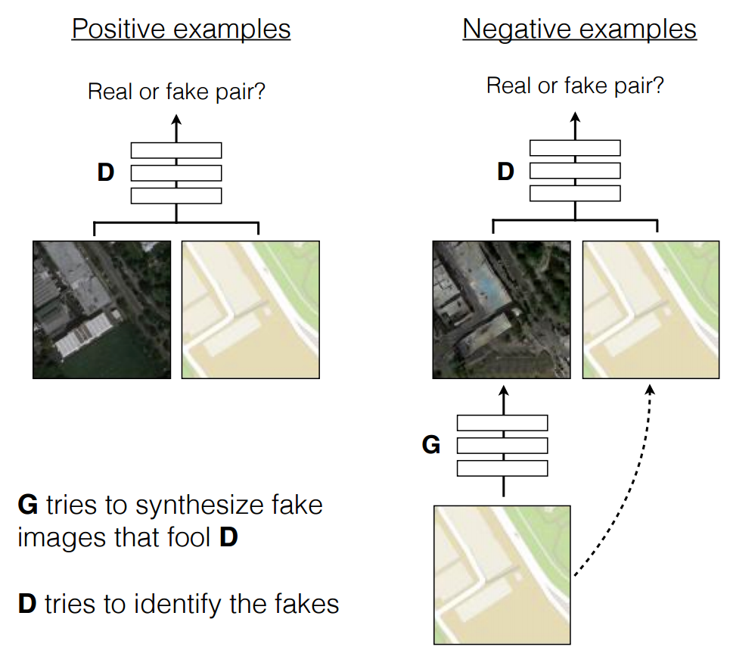
[Isola et al. CVPR 2017]

Slide 15
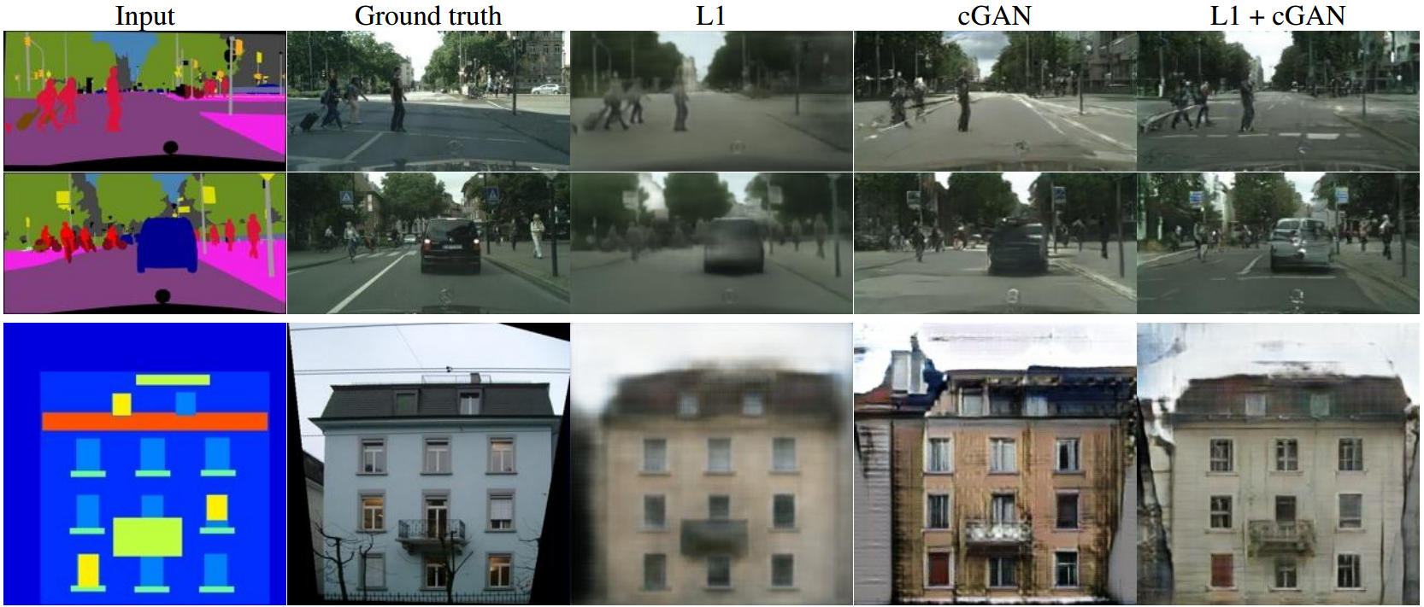
Label2Image
[Isola et al. CVPR 2017]

Slide 16
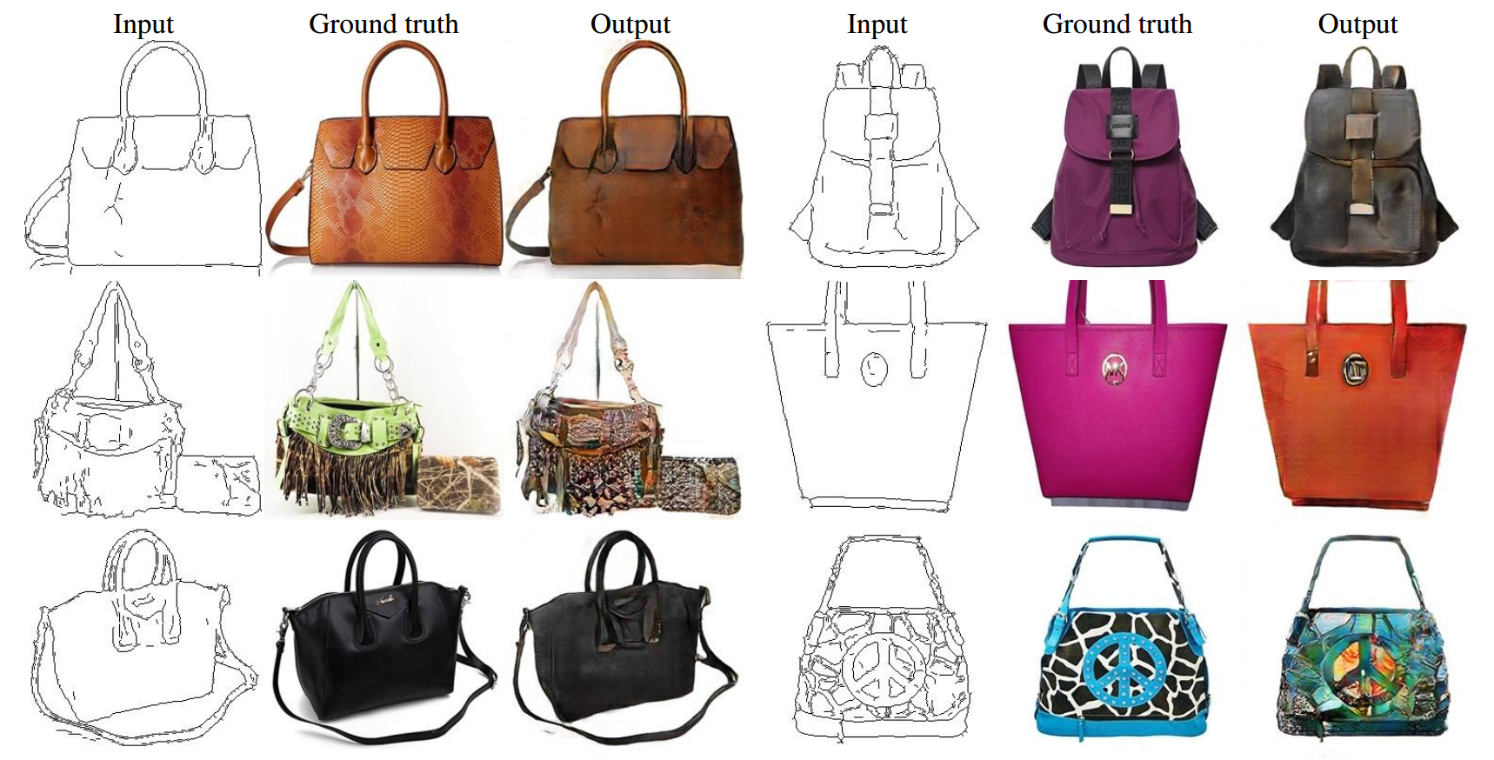
Edges2Image
[Isola et al. CVPR 2017]

Slide 17
Generative Visual Manipulation
[Zhu et al. ECCV 2016]

Slide 18
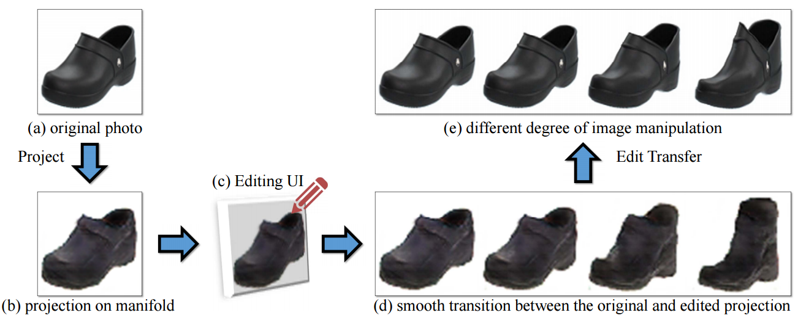
[Zhu et al. ECCV 2016]

Slide 19
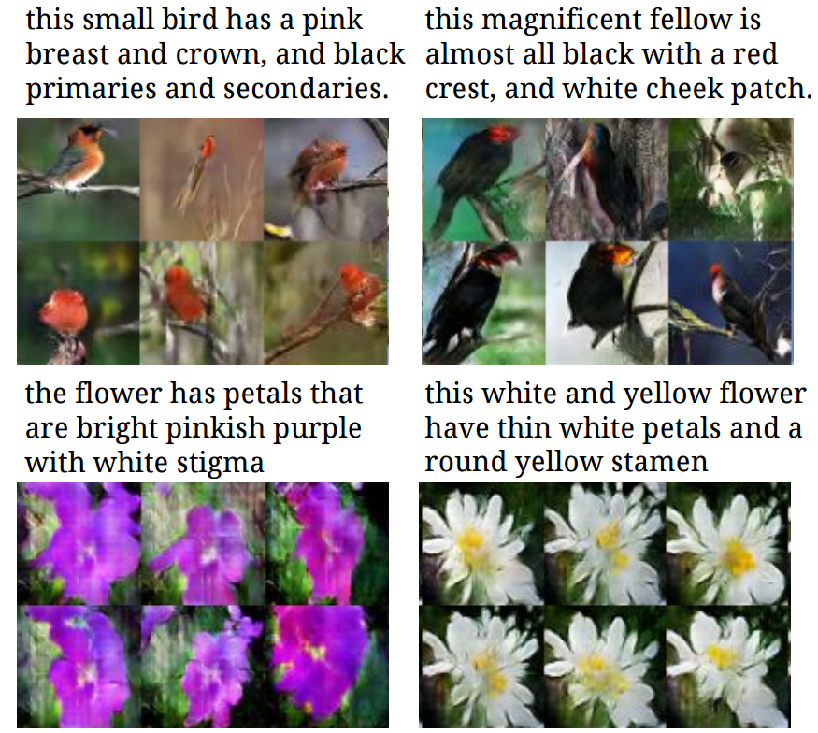
Text2Image
[Reed et al. ICML 2016]

Slide 20
Text2Image
F
Positive samples:
real image + right texts
Negative samples:
fake image + right texts
Real image + wrong texts
[Reed et al. ICML 2016]

Slide 21
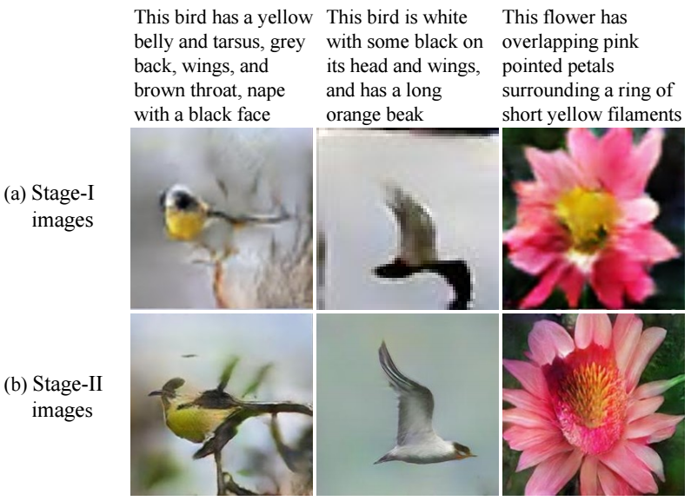
StackGAN
[Zhang et al. 2016]

Slide 22
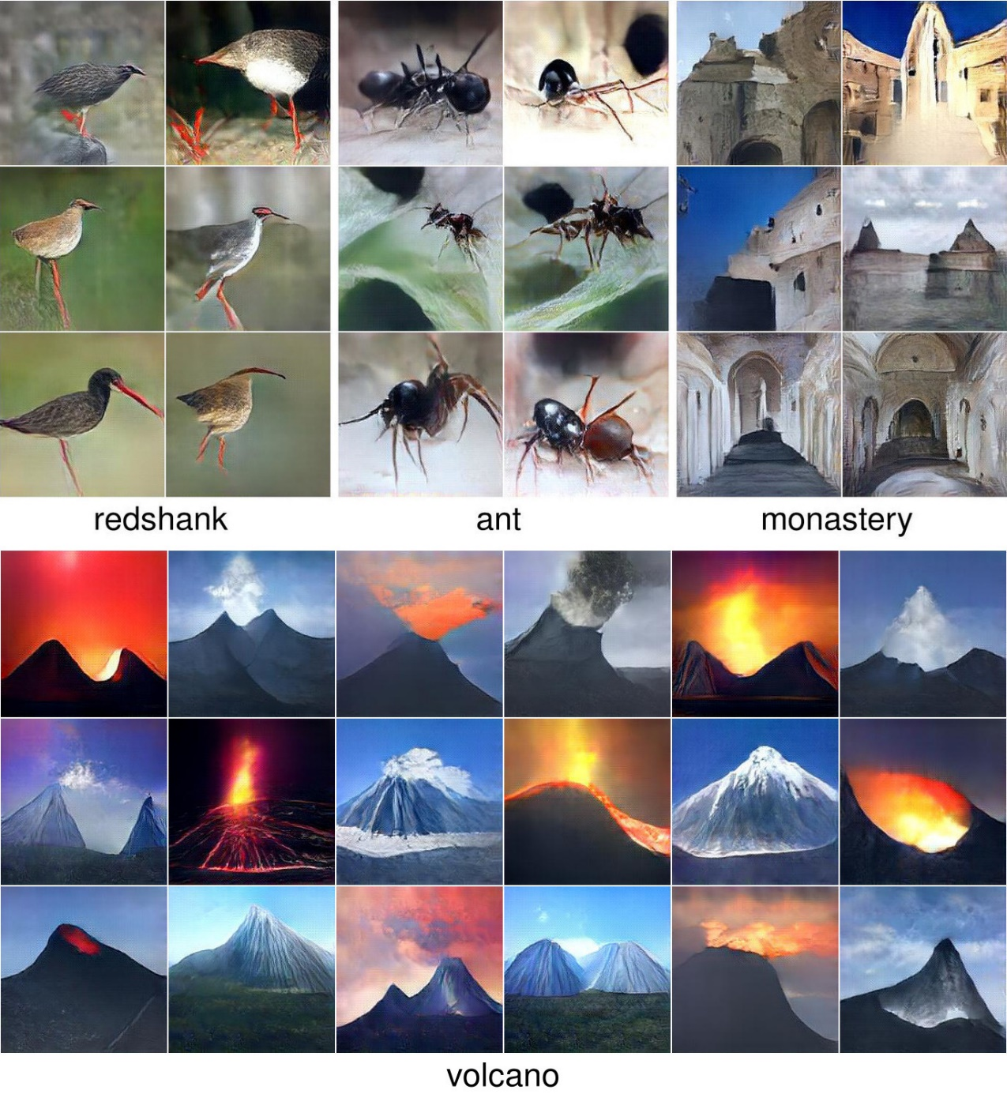
Plug & Play Generative Networks
[Nguyen et al. 2016]

Slide 23
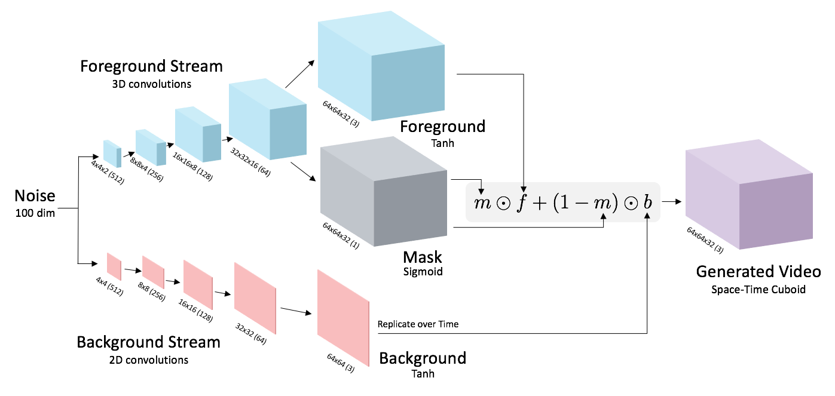
Video GAN
Videos http://web.mit.edu/vondrick/tinyvideo/
[Vondrick et al. NIPS 2016]

Slide 24
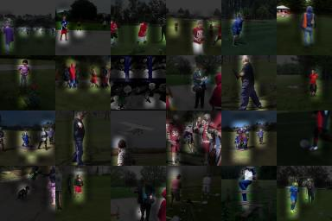
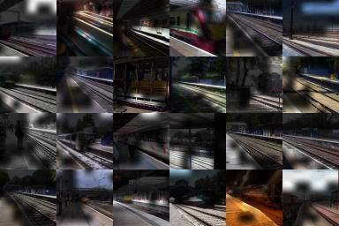
Generative Modeling as Feature Learning
[Vondrick et al. NIPS 2016]

Slide 25
Shape modeling using 3D Generative Adversarial Network
[Wu et al. NIPS 2016]

Slide 26
Things to remember
GANs can generate sharp samples from high-dimensional output space
Conditional GAN can serve as general mapping model X->Y
No need to define domain-specific loss functions
Handle one-to-many mappings
Handle multiple modalities

